Slide 1

Artificial Intelligence
Chapter 3: Problem Solving Agent

Slide 2
Objectives of the Chapter
• Problem Solving Agents
• Problem Formulation
• Search Strategies
• Informed & Un-informed
2

Slide 3
Problem Solving Agent
Searching is one of the classic areas of AI
Problem Solving agents are one kind of goal-based agent that acts Rationally.
Problem Solving Agent
An agent that tries to come up with a sequence of actions by performing some kind of search algorithm in the background that will bring the environment into a desired state/goal.
Search
The use of search requires an abstract formulation of the problem and the available steps to construct solutions.
we need to first formulate the problem.
3

Slide 4
Problem Formulation
6.Solution
1.State
2.Initial State
3.Actions
4.Goal Test
5.Path Cost
A State Space
Set of all possible states where you can be.
A Start State. The state from where the search begins.
A Goal Test. A function that looks at the current state returns whether or not it is the goal state.
Solution to a search problem is a sequence of actions, called the plan that transforms the start state to the goal state.
THIS PLAN IS ACHIEVED THROUGH SEARCH ALGORITHMS

Slide 5
NOTE
Solution Quality is measured by the Path cost function, and an Optimal solution has the lowest path cost among all solutions

Slide 6
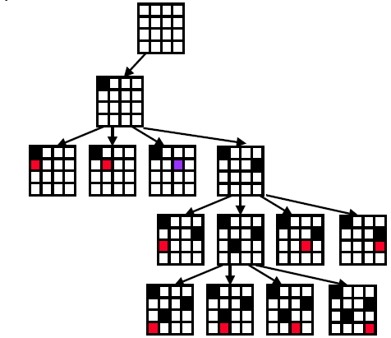
4 Queens Problem Example

Slide 7
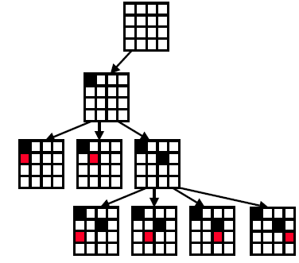
4 Queens Problem Example………

Slide 8
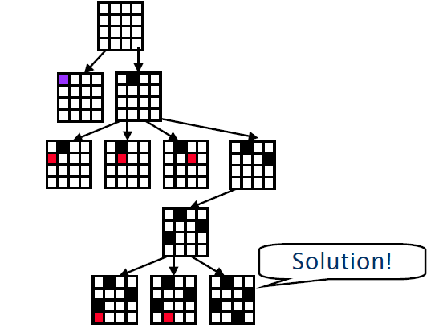
4 Queens Problem Example………

Slide 9
The 8- Puzzle Example
State: The location of the eight tiles, and the blank
Initial State: {(2,0), (8,1), (3,2),
(1,3), (6,4), (4,5), (7,6), (-,7), (5,8)}
Successor Function: four actions (blank moves Left, Right, Up, Down).
Goal Test: determine a given state is a goal state.
Path Cost: each step costs 1
Solution: {(1,0),(2,1),(3,2) ,(8,3) ,(-,4) ,(4,5) ,(7,6) ,(6,7)
,(5,8)}
2 | 8 | 3
1 | 6 | 4
7 | - | 5
1 | 2 | 3
8 | - | 4
7 | 6 | 5
Initial State
Goal State
12

Slide 10
2 | 8 | 3
1 | 6 | 4
7 | - | 5
2 | 8 | 3
1 | - | 4
7 | 6 | 5
1 | 2 | 3
8 | - | 4
7 | 6 | 5
2 | - | 3
1 | 8 | 4
7 | 6 | 5
- | 2 | 3
1 | 8 | 4
7 | 6 | 5
Goal
1 | 2 | 3
- | 8 | 4
7 | 6 | 5
1 | 2 | 3
8 | - | 4
7 | 6 | 5

Slide 11
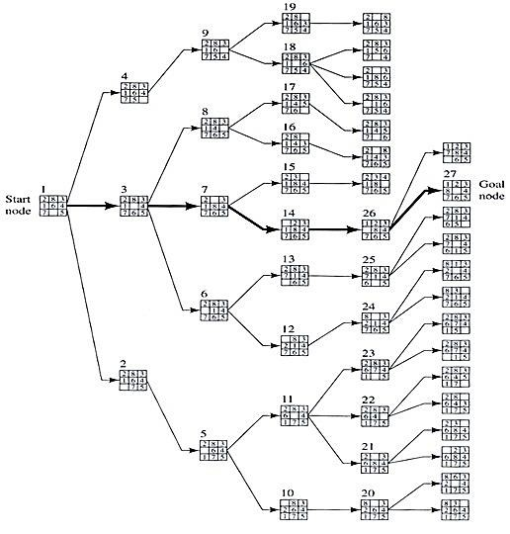

Slide 12
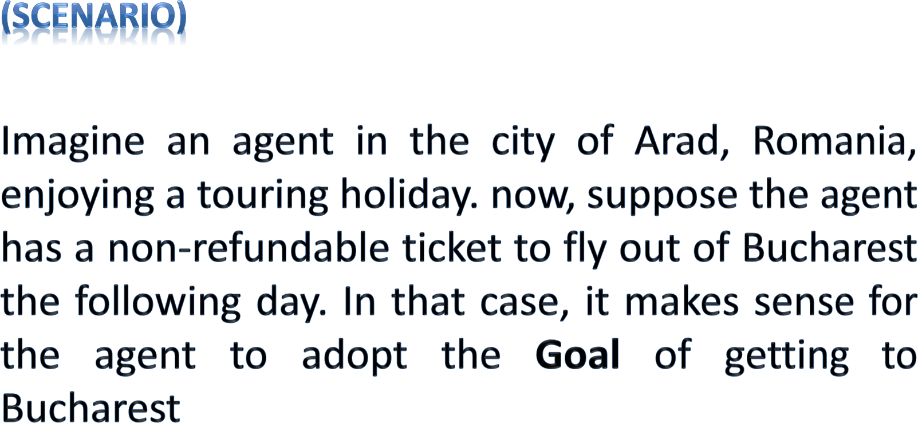

A Touring Agent Problem

Slide 13
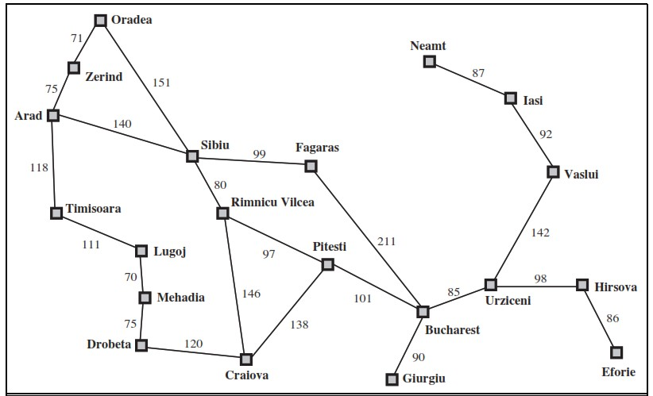
Problem Formulation (The Romania Example)
State: We regard a problem as state space, here a state is a City
Initial State: the state to start from
In (Arad)
Successor Function: description of the possible actions, give state x, S(X)
returns a set of <action, successor> ordered pairs.
S(x)= { <Go(Sibiu), In(Sibiu)>, <Go(Timisoara), In(Timisoara)>,
<Go(Zerind),In(Zerind)> }
Goal Test: determine a given state is a goal state.
In(Sibiu) →No. In(Zerind) →No.…. In(Bucharest)→Yes!
Path Cost: a function that assigns a numeric cost to each path.
e.g., sum of distances, number of actions executed, etc.
c(x,a,y) is the step cost, assumed to be ≥ 0
Solution: a sequence of actions leading from the initial state to a goal state
{Arad →Sibiu → Rimnicu Vilcea → Pitesti → Bucharest}
8

Slide 14
Problems
Vacuum Cleaner
8-Puzzle
8-Queens Problem
Robotic Assembly
VLSI Layout

Slide 15
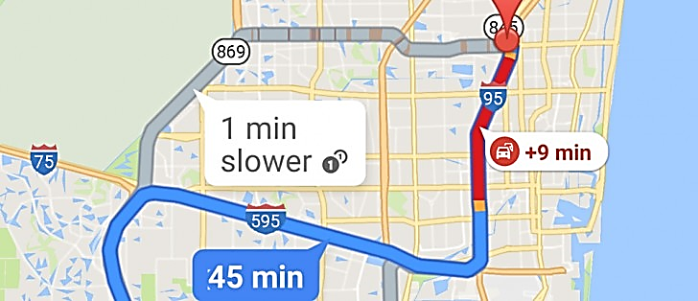
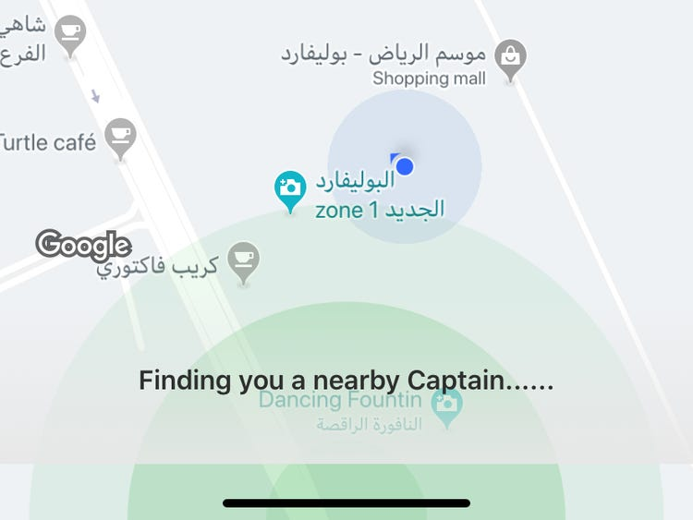
Problem Formulation (Real-life Applications)
Car Navigation
Route Finding Problem
Nearby Captain
States
locations
Initial state
starting point
Successor function (operators)
move from one location to another
Goal test
arrive at a certain location
Path cost
may be quite complex
money, time, travel comfort, scenery,
12

Slide 16
Examples:
Military Operation Planning
Train Travel Planning
Airline Travel Planning
Routing in Computer Networks

Slide 17
Search Algorithms
Uninformed Search
Informed Search
Uninformed Search
breadth-first
uniform-cost search
depth-first
depth-limited search
iterative deepening
bi-directional search
Informed Search
Greedy best-first
A*
(heuristic search)
agent has background information about the problem
(blind search)
number of steps, path cost unknown
agent knows when it reaches a goal

Slide 18
Uninformed (Blind Search)
The Uninformed Search does not contain any domain knowledge such as closeness or location of goal.
It operates in a brute force way, as it only includes information about how to traverse the tree and how to identify leaf and goal nodes.
Uninformed Search applies a way in which search tree is searched without any information, so it is called blind search.
It examines each node until it achieves the goal
node.
18

Slide 19
Evaluation of Search Strategies
A search strategy is defined by picking the order of node expansion
Strategies are evaluated along the following dimensions:
Completeness: if there is a solution, will it be found
Time complexity: How long does it takes to find the
solution
Space complexity: memory required for the search
Optimality: will the best solution be found
Time and space complexity are measured in terms of
b: maximum branching factor of the search tree
d: depth of the least-cost solution
m: maximum depth of the state space (may be ∞)
29

Slide 20
1. Breadth-First Search (BFS) Algorithm

Slide 21
Breadth-First Search
It is the most common search strategy for traversing a tree or graph.
This algorithm searches breadthwise in a tree or graph, so it is called breadth-first search.
BFS algorithm starts searching from the root node of the tree and further are traversed in level-order, where we visit every node on a level before going to a lower level.
It starts at the tree root (or some arbitrary node of a graph)
BFS is implemented using FIFO Queue data structure.

Slide 22
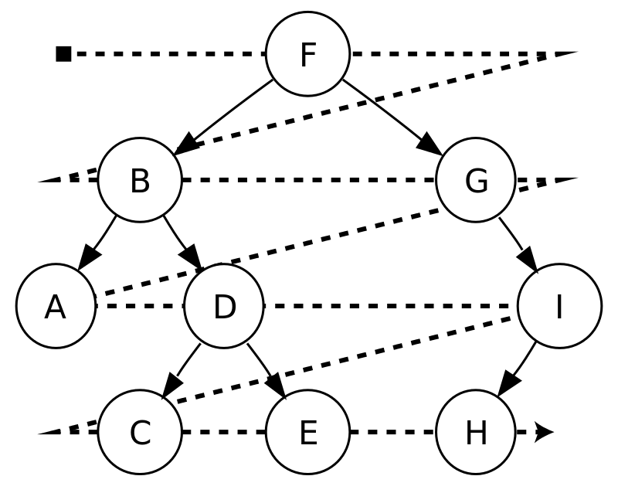
Example: BFS
For example, after searching F, then B, then G, the search proceeds with A,D, I, C, E,H
Node are explored in the Level order F,B,G,A,D,I,C,E,H

Slide 23
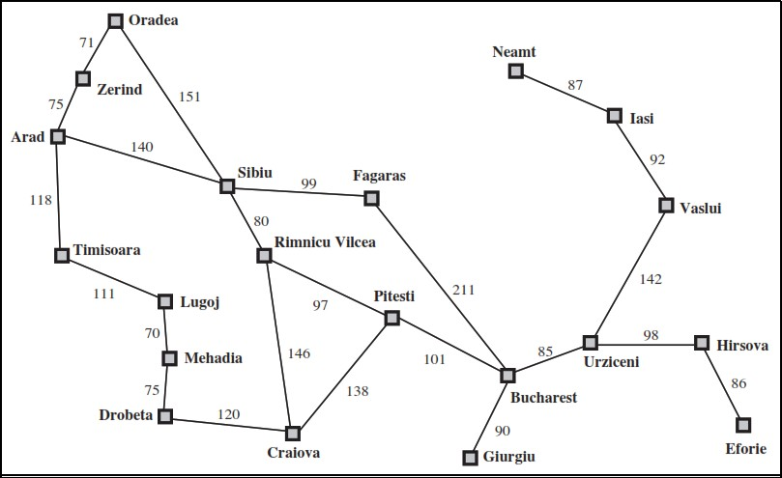
Example: Romania
You are in Arad and want to go to Bucharest
➔ How to design an intelligent agent to find the way between 2 cities?
4

Slide 24
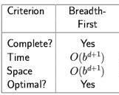
Properties of Breadth-First Search (BFS)
Completeness: Yes (if b is finite), a solution will be found if exists.
Time Complexity: (nodes until the solution) Optimality: Yes
b d
Branching Factor The depth of the goal
Suppose the branching factor b=3, and the goal is at depth d=20:
– Then we need 3²⁰ time to finish.
➔Not suitable for searching large graphs

Slide 25
2- Uniform-Cost -First

Slide 26
The primary goal of the uniform-cost search is to find a path to the goal node which has the lowest cumulative cost. Uniform-cost search expands nodes according to their path costs form the root node. It can be used to solve any graph/tree where the optimal cost is in demand. Uniform cost search is equivalent to BFS algorithm if the path cost of all edges is the same.
Uniform-Cost -First

Slide 27
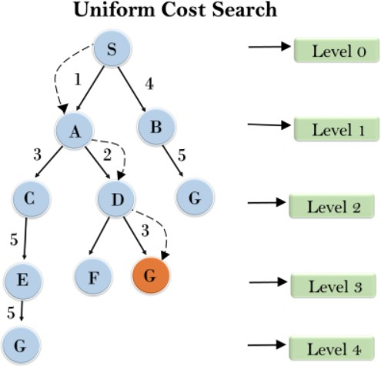

Slide 28
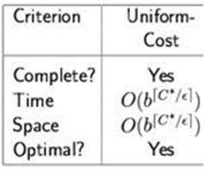
Properties of Uniform-cost Search (UCS)
Completeness Uniform-cost search is complete, such as if there is a solution, UCS will find it.
Time Complexity much larger than b^{d}, and just b^{d} if all steps have the same cost.
Space Complexity: as above
Optimality: Uniform-cost search is always optimal as it only selects a path with the lowest path cost.

Slide 29
3- Depth-First Search

Slide 30
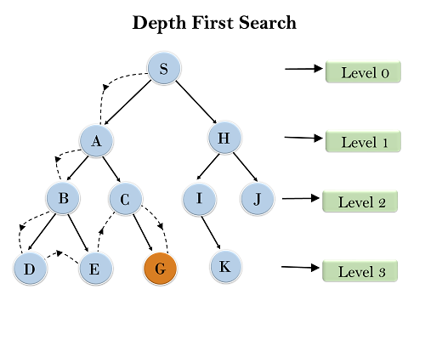
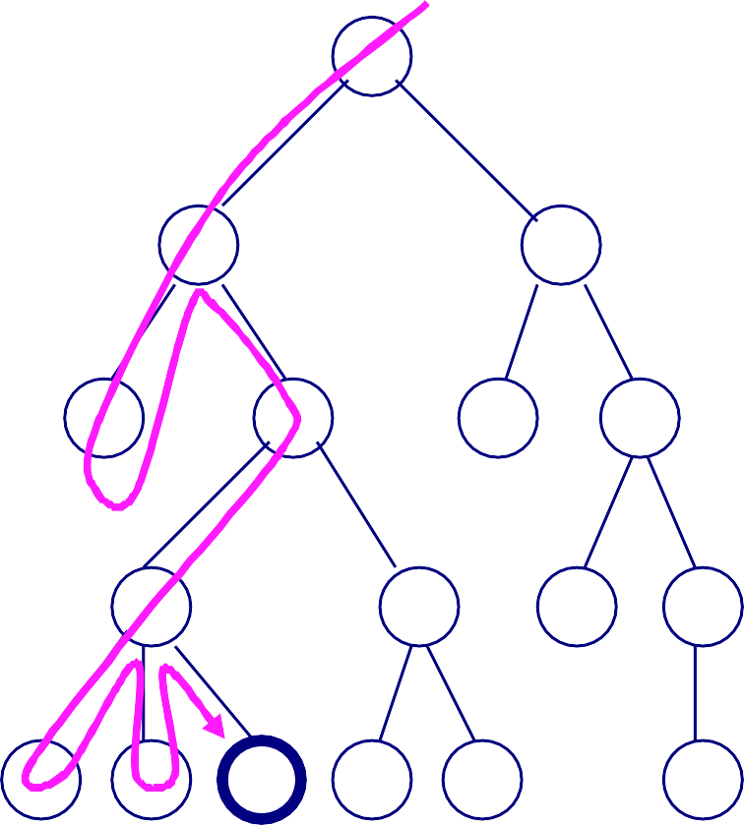
Depth-First Search
Based on [4]
A
It will start searching from root node S, and traverse A, then B, then D and E, after traversing E, it will backtrack the tree as E has no other successor and still goal node is not found.
After backtracking it will traverse node C and then G, and here it will terminate as it found goal node.
B
C
D
E
F G
H
I
J K
L M N O P
Q

Slide 31
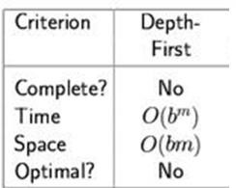
Properties of Depth-First Search
Complete: No: fails in infinite-depth spaces, spaces with loops
– Yes, complete in finite spaces
Time: O(b^{m}): terrible if m is much larger than d
– but if solutions are dense, may be much faster than breadth-first
Space: O(bm)
Optimal: No

Slide 32
4- Depth-Limited Search

Slide 33
4- Depth-Limited Search
A depth-limited search algorithm is similar to depth-first search with a predetermined limit.
Depth-limited search can solve the drawback of the infinite path in the Depth-first search.
In this algorithm, the node at the depth limit will treat as it has no successor nodes further.
Depth-limited search can be terminated with two Conditions of failure:
Standard failure value: It indicates that problem does not have any solution.
Cutoff failure value: It defines no solution for the problem within a given depth limit.

Slide 34
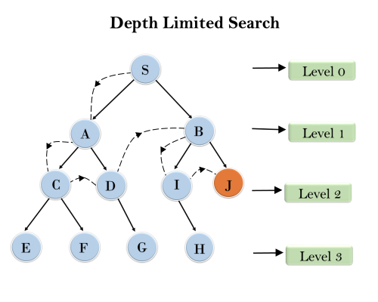
Example

Slide 35
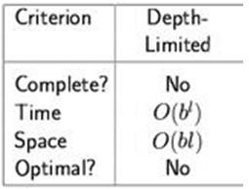
4- Depth-Limited Search
Complete: no (if goal beyond l (l<d), or infinite branch length)
Time: O(b^{l)}
Space: O(bl)
Optimal: No (if l < d)
83

Slide 36
5- Iterative Deepening Depth-First Search

Slide 37
5- Iterative Deepening Depth-First Search
The iterative deepening algorithm is a combination of DFS and BFS algorithms.
This search algorithm finds out the best depth limit and does it by gradually increasing the limit until a goal is found.
This algorithm performs depth-first search up to a certain "depth limit", and it keeps increasing the depth limit after each iteration until the goal node is found.
This Search algorithm combines the benefits of Breadth-first search's fast search and depth-first search's memory efficiency.
The iterative search algorithm is useful uninformed search when search space is large, and depth of goal node is unknown.

Slide 38
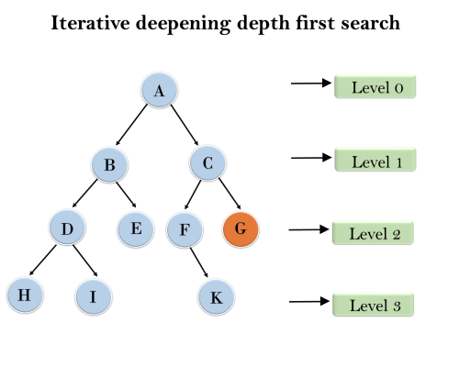
5- Iterative Deepening Depth-First Search
1'st Iteration-----> A
2'nd Iteration----> A, B, C
3'rd Iteration------>A, B, D, E, C, F, G
4'th Iteration------>A, B, D, H, I, E, C, F, K, G In the fourth iteration, the algorithm will find the goal node.

Slide 39
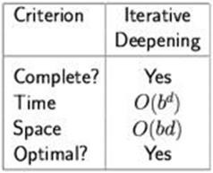
Properties of Iterative Deepening Search
Complete: Yes (if the b is finite)
Time: O(b^{d})
Space: O(bd)
Optimal: Yes, if step cost = 1
93

Slide 40
6- Bi-directional Search

Slide 41
6- Bi-directional Search
Bidirectional search algorithm runs two simultaneous searches, one form initial state called as forward-search and other from goal node called as backward-search, to find the goal node.
Bidirectional search replaces one single search graph with two small subgraphs in which one starts the search from an initial vertex and other starts from goal vertex.
The search stops when these two graphs intersect each other.
Bidirectional search can use search techniques such as BFS, DFS, etc.

Slide 42
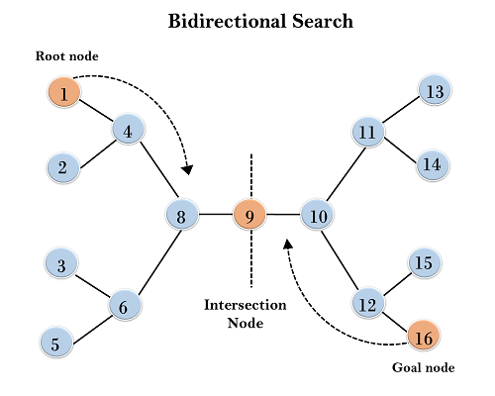
Bi-directional Search Example
In the below search tree, bidirectional search algorithm is applied. This algorithm divides one graph/tree into two sub-graphs. It starts traversing from node 1 in the forward direction and starts from goal node 16 in the backward direction.
The algorithm terminates at node 9 where two searches meet.

Slide 43
6- Bi-directional Search
Completeness: Bidirectional Search is complete if we use BFS in both searches.
Time Complexity: Time complexity of bidirectional search using BFS is O(b^{d}).
Space Complexity: Space complexity of bidirectional search is O(b^{d}).
Optimal: Bidirectional search is Optimal.

Slide 44
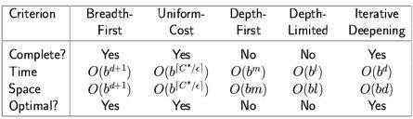
Summary
Problem formulation
Variety of uninformed search strategies

